Slide 1

CommUnity: Seamless Community Interaction and Management
Batch 2
1.Gauri Kulkarni
2.Harsh Dubey
3.Yash Joshi
4.Naga Devi Muthyam

Slide 2
Work contributed :
Gauri Kulkarni – Frontend Backend Integration
Yash Joshi - Backend
Harsh Dubey – Frontend
Naga Devi Muthyam - Frontend

Slide 3
Abstract:
Overview:
CommUnity is a modular, multi-tenant community management system designed to simplify housing society management. The platform connects members, streamlines daily activities, and enhances community engagement. This platform provides an efficient interface for both administrators and residents, management, facilitating interaction, and engagement within the community.
Key Features:
Simplify housing society management
Enhance communication between residents and administrators
Increase resident participation in community activities
Facilitate transparent financial transactions
Improve community safety and security

Slide 4
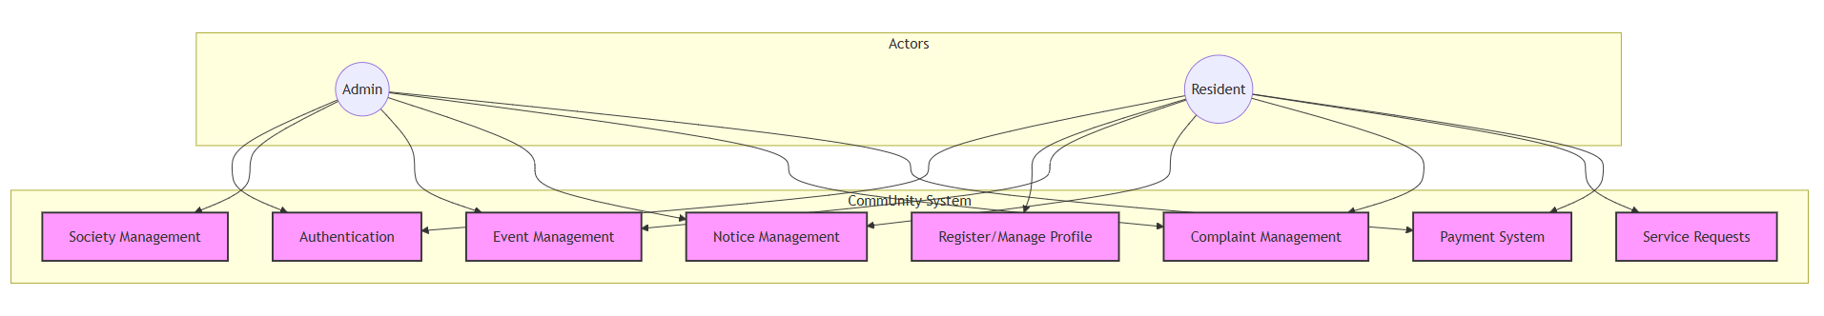
Use Case Diagram :

Slide 5
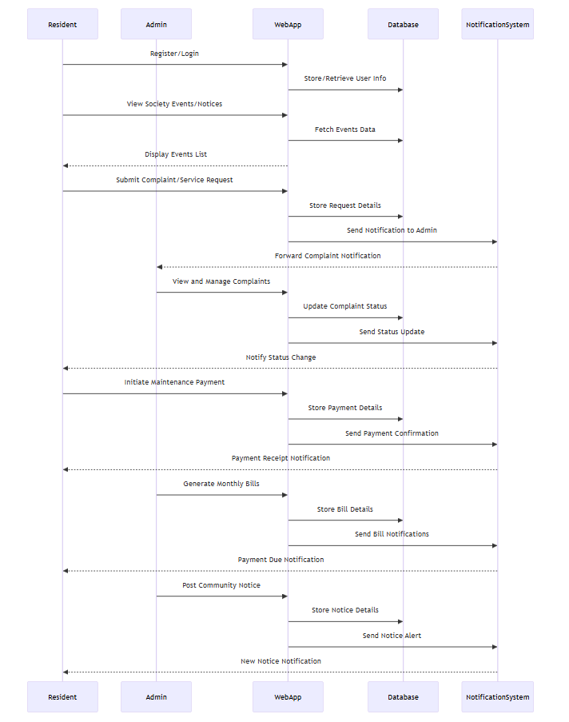
Sequence Diagram :

Slide 6
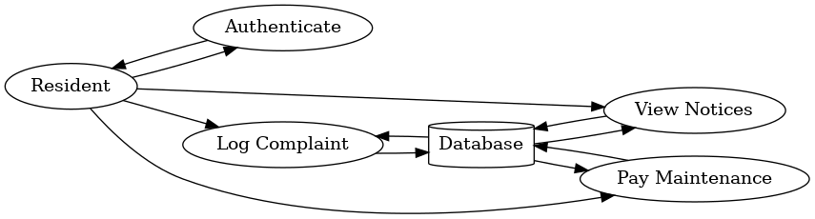
DFD For Resident:

Slide 7
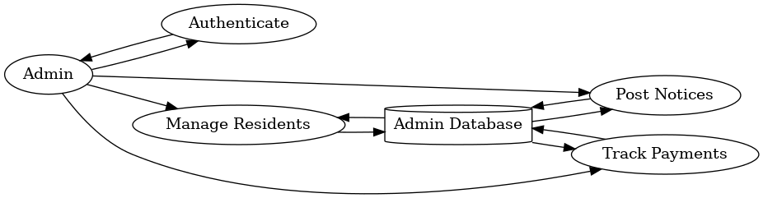
DFD For Admin:

Slide 8
Modules:
Milestone 1:
User Authentication and Registration
Milestone 2:
Resident and Society Management
Milestone 3:
Event and Notice Management
Complaint and Service Request Management
Milestone 4:
Maintenance Payment System

Slide 9
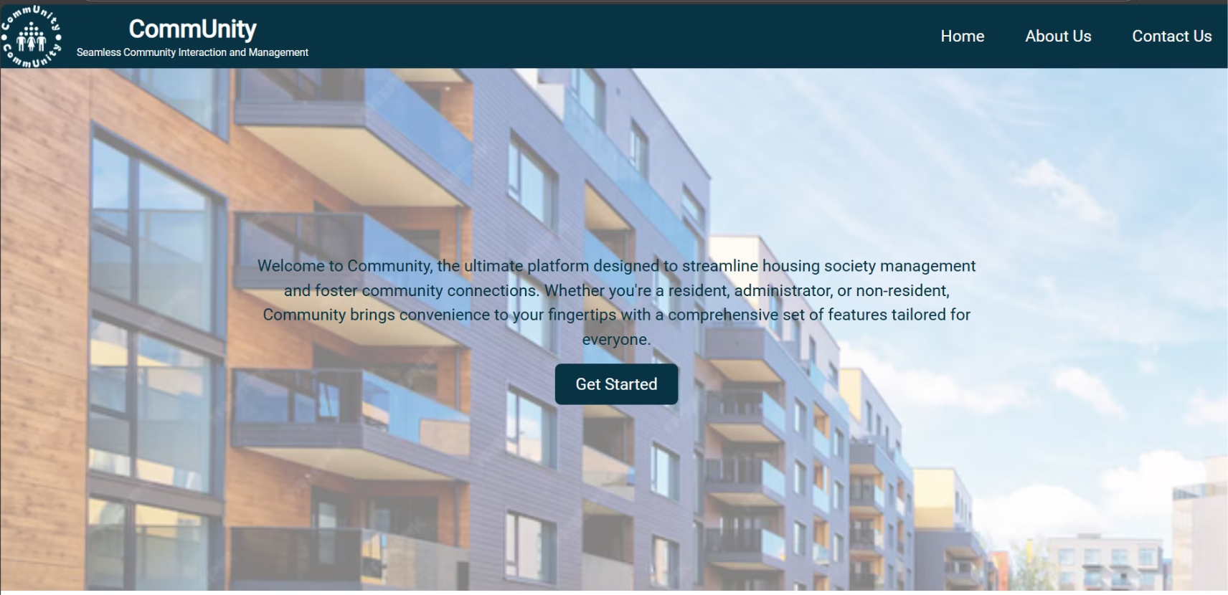

Slide 10
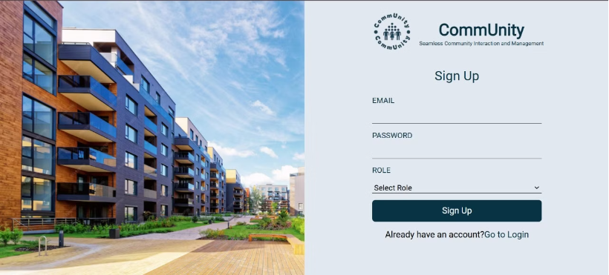
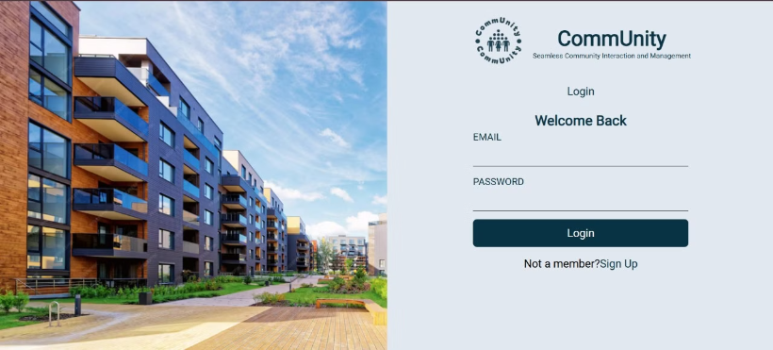
Sign Up And Login Page:

Slide 11
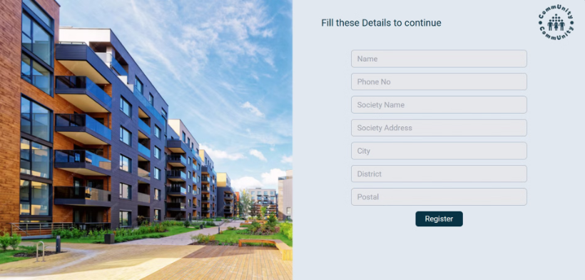
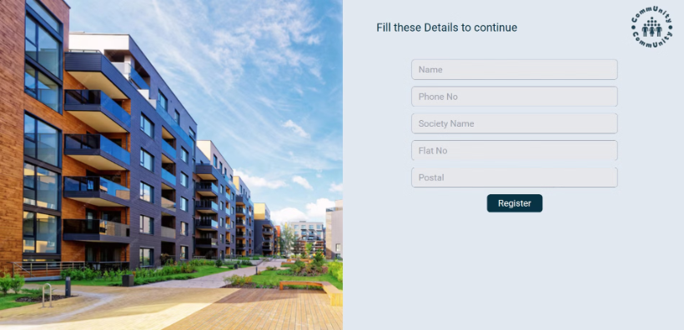
Admin and User Registration Forms:

Slide 12
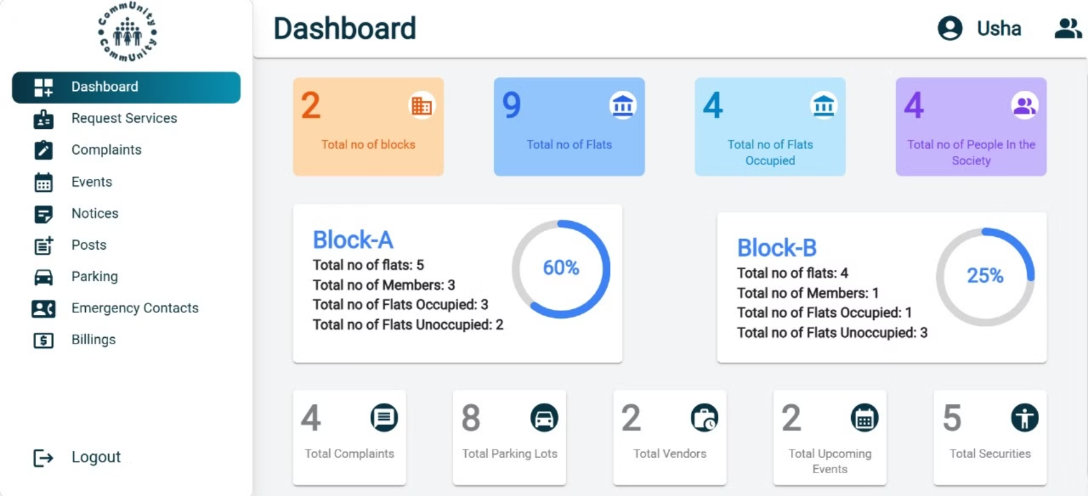

Slide 13
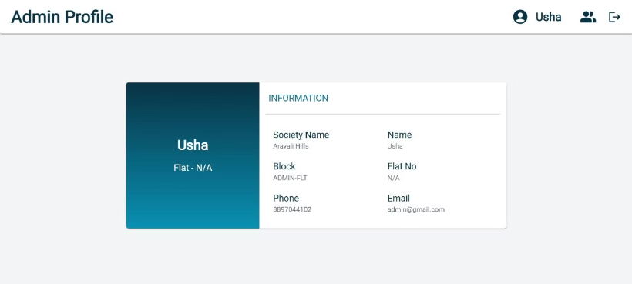
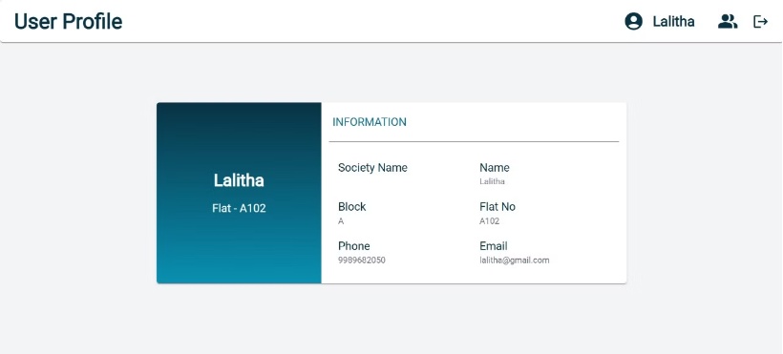
Admin And User Profile:

Slide 14
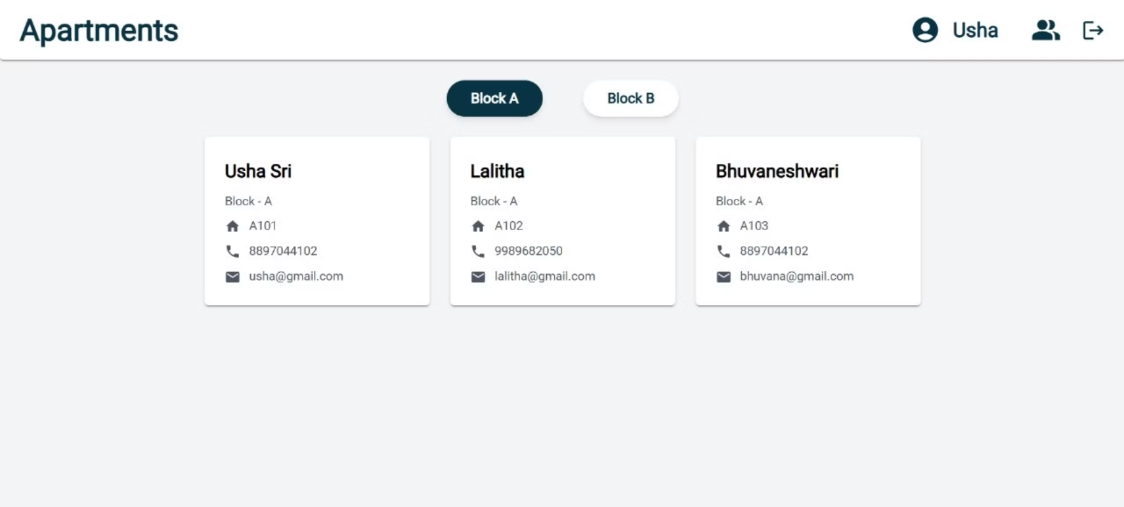

Slide 15
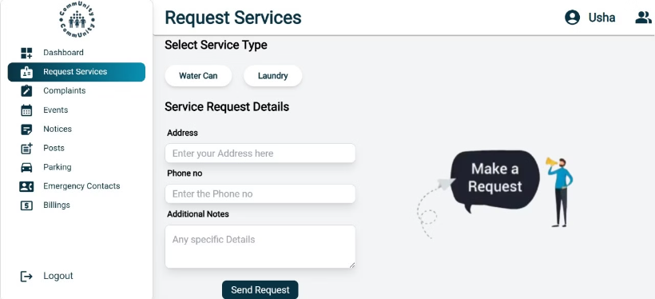
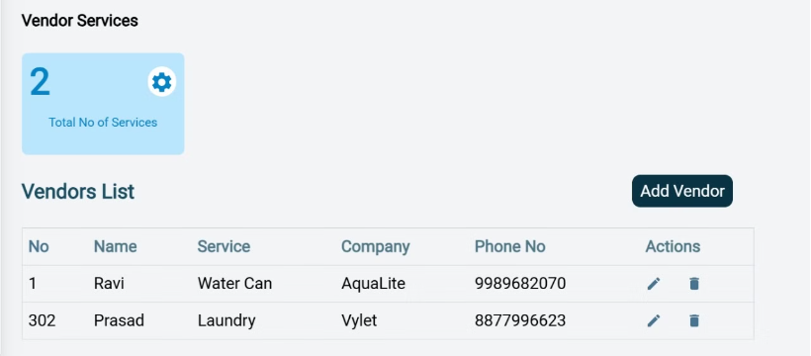
Request Services:

Slide 16
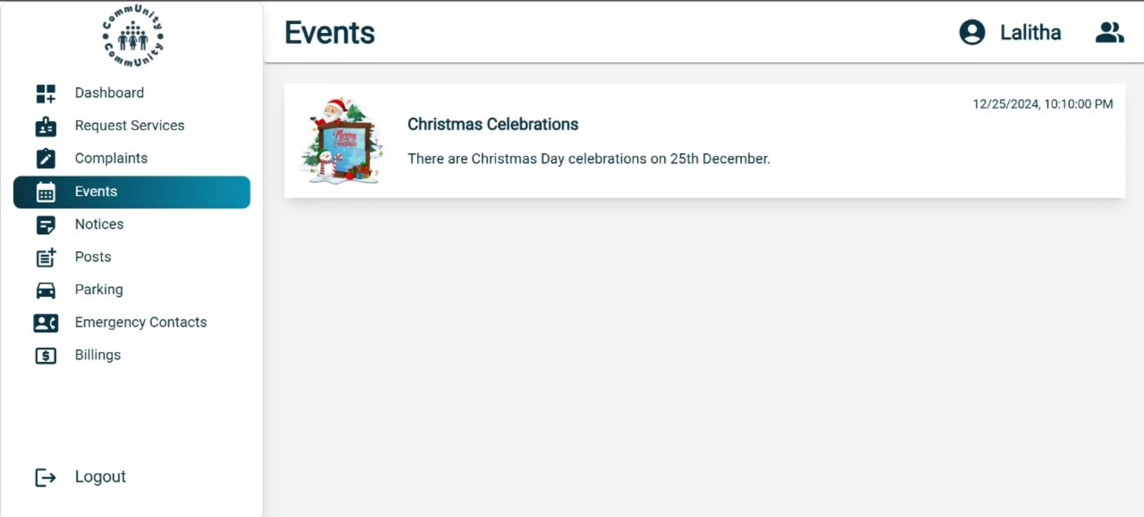
Notice Forms:

Slide 17
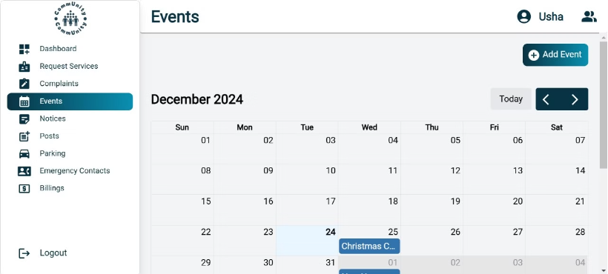
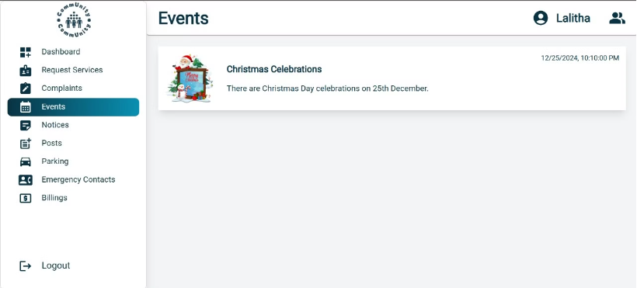
Events Forms:

Slide 18
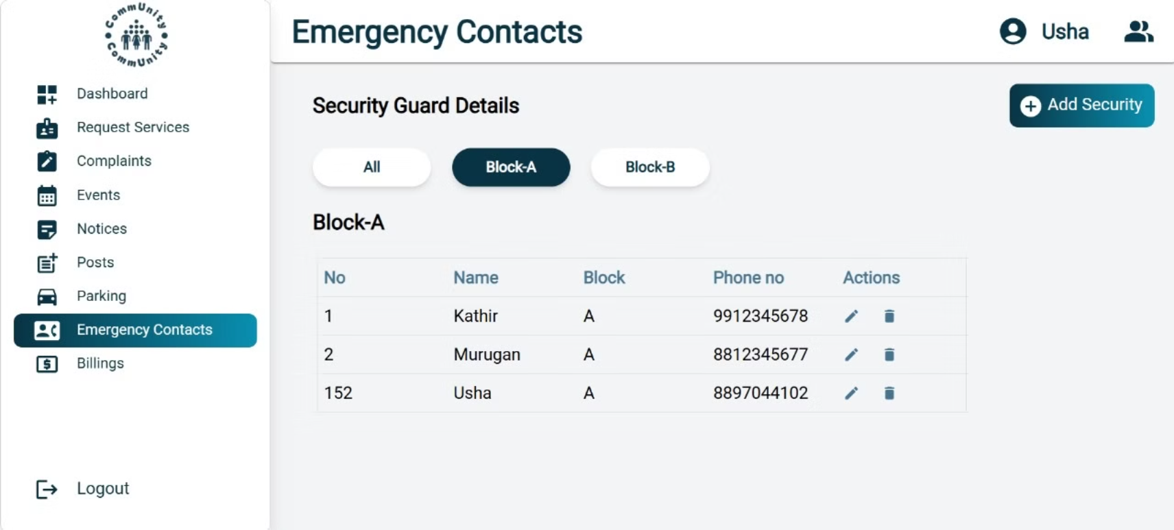

Slide 19
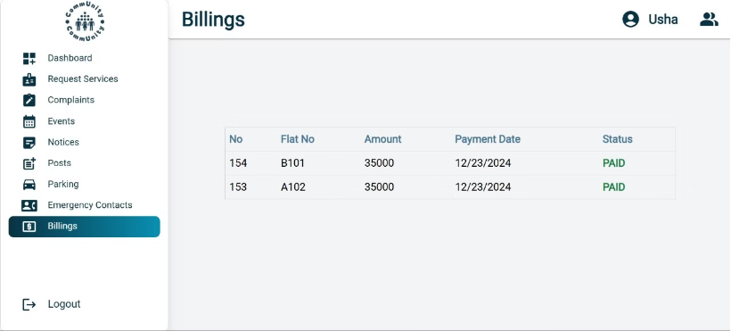
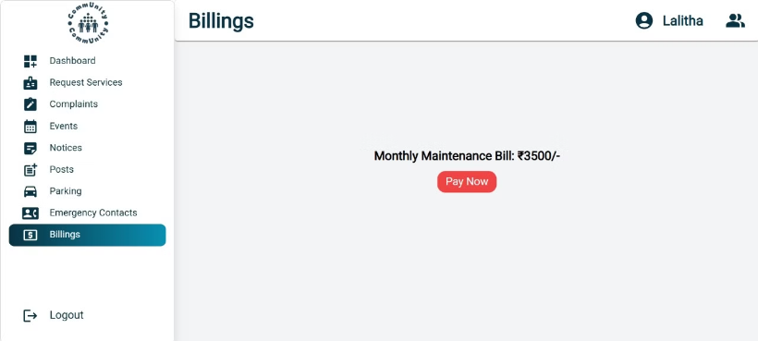
Billings:

Slide 20
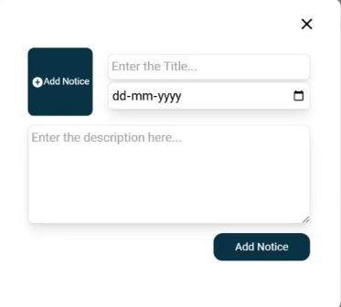

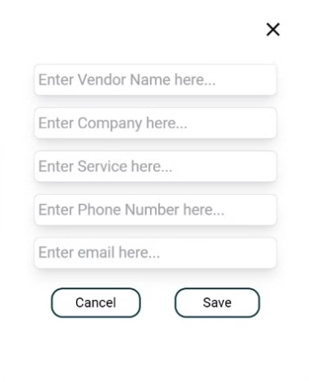
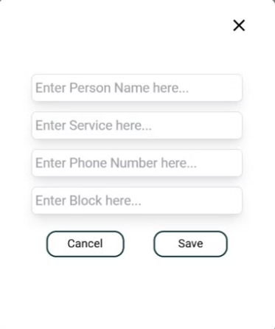
Form Design:
Notice Form
Event Form
Vendor Form
Emergency Contact Form

Slide 21
Conclusion:
CommUnity is a comprehensive and modular solution designed to revolutionize housing society management. By seamlessly integrating functionalities like resident and society management, event and notice management, complaint handling, and online payment systems, the platform fosters efficient communication and streamlined daily operations.
This project not only simplifies administrative tasks for society managers but also enhances the overall living experience for residents by promoting engagement and transparency. Through innovative features and user-friendly interfaces, CommUnity demonstrates the potential to transform community interactions and establish a new standard for modern housing societies.
The successful implementation of this project highlights the importance of technology in building connected and harmonious communities.

